Slide 1
Evaluating the effectiveness of non-contact pressure monitoring via multispectral imaging using Kubelka-Munk approach

Slide 2
Outline
Introduction
Diabetic Foot
Normalization
ROI
Table
Summary

Slide 3
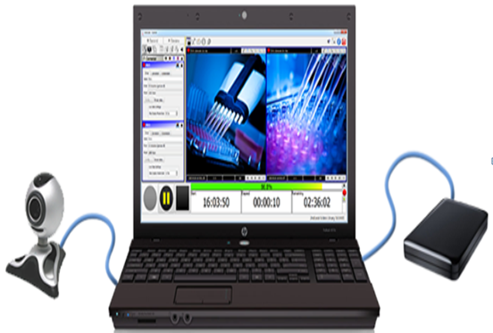
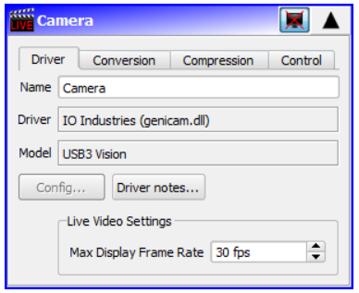
Introduction
2ndlook software
Video recording software

Slide 4
Cont…
Multi Spectral Imaging
Captures image data within specific wavelength ranges
Revealing details beyond human vision
Biomedical Multispectral Imaging System
Have 4 bands suitable for detecting hemoglobin and lipid
735, 800, 865, and 930 nm
Used for a number of analysis
oxygen saturation and total hemoglobin
Important for monitoring tissue health

Slide 5
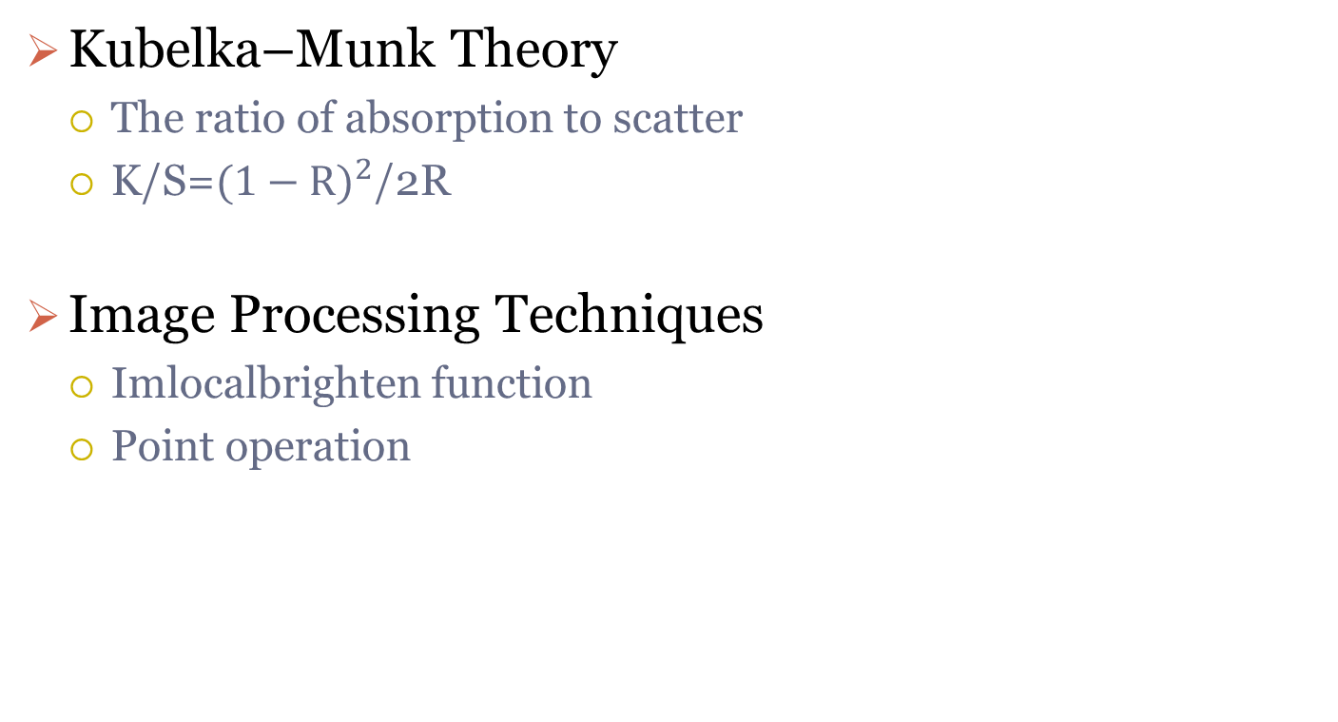
Cont…
Kubelka–Munk Theory
The ratio of absorption to scatter
K/S=${(1−R)}^{2}$/2R
Image Processing Techniques
Imlocalbrighten function
Point operation

Slide 6
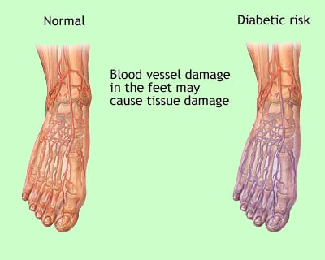
Diabetic Foot
Too high blood glucose, or sugar level
Doppler is ratio between flow at brachial artery and the ankle
Normal ABI ranges from 1.0 — 1.4

Slide 7
Parameters
Standard Normal Variate (SNV): (Img-mean)/std
Kurtosis: A measure of whether the data are heavy-tailed or light-tailed relative to a normal distribution
Skewness: Measure of symmetry
Energy: Refers to the amount of information or the "smoothness" of the image
Entropy: Measures the amount of uncertainty or randomness in an image
Power Spectral Density (PSD)
Resolution: width per pixel
FDR: Fisher Discriminant Ration

Slide 8
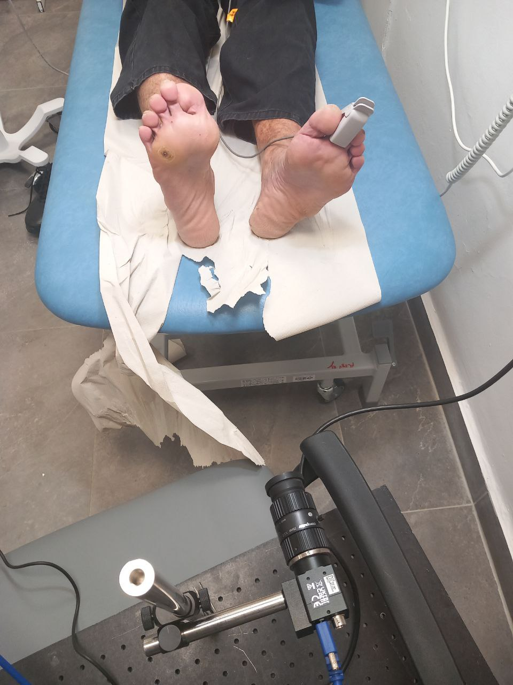
Patient Details(Subject#16)
Gender: Male
Saturation:
left: 95
right: 98
Age: 58
Left: Normal
Right: Pressure
Resolution: 0.004 cpp
Distance:36 cm
Exp date: 25/02/25

Slide 9
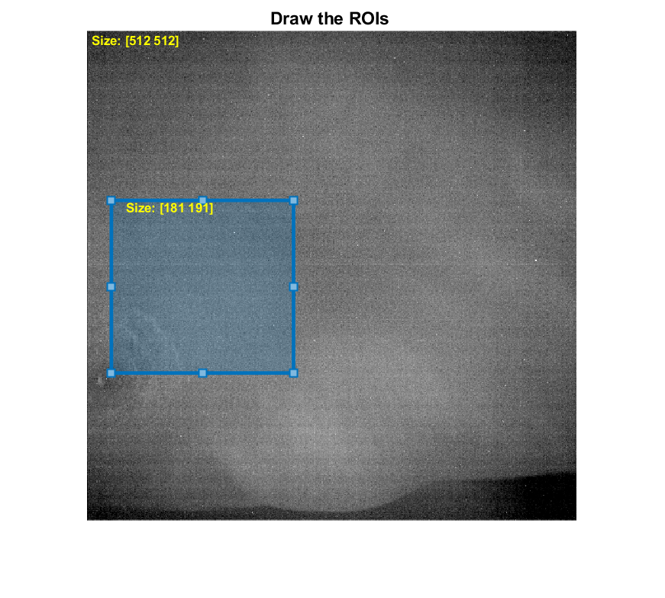
Normalization (ROI)

Slide 10

Leg Position
Normal Foot Diabetic Foot

Slide 11
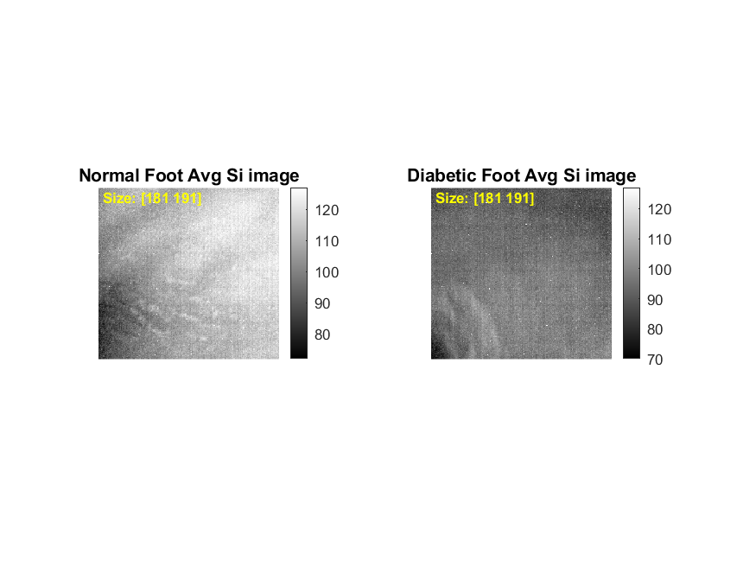
Average (n=26) Si Images @930 nm

Slide 12
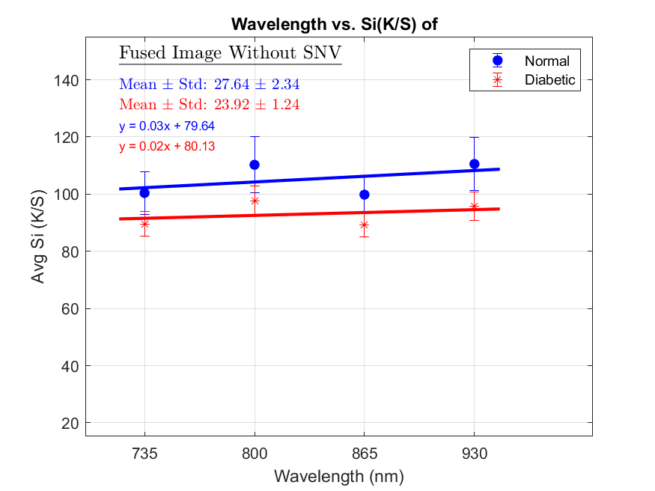
Avg Si of 26 images
Fused Image without SNV 47.44±4.23|58.93±5.69

Slide 13
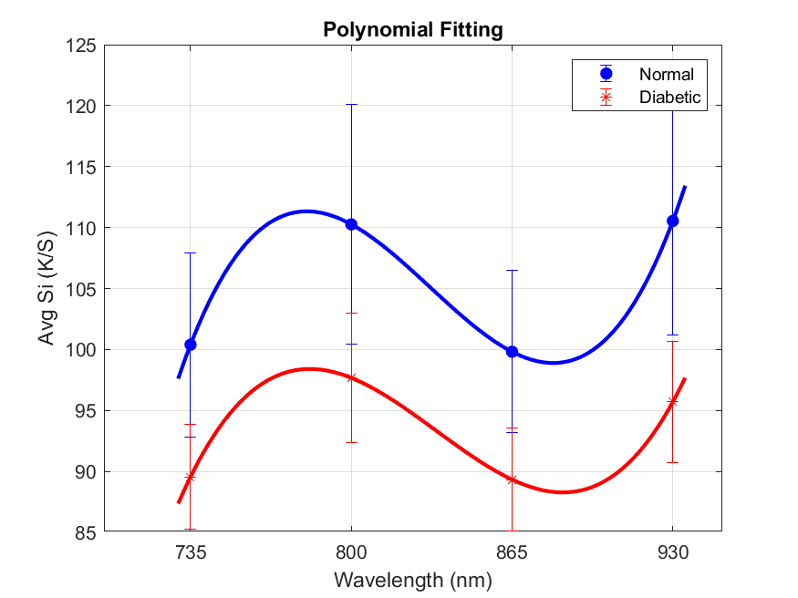
Avg SI Vs. Wavelength

Slide 14
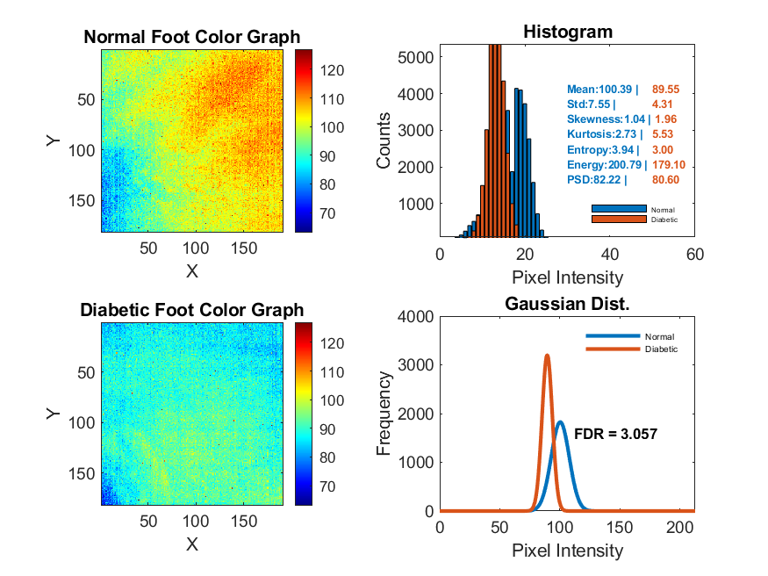
Normal Vs. Diabetic Foot (735 nm)

Slide 15
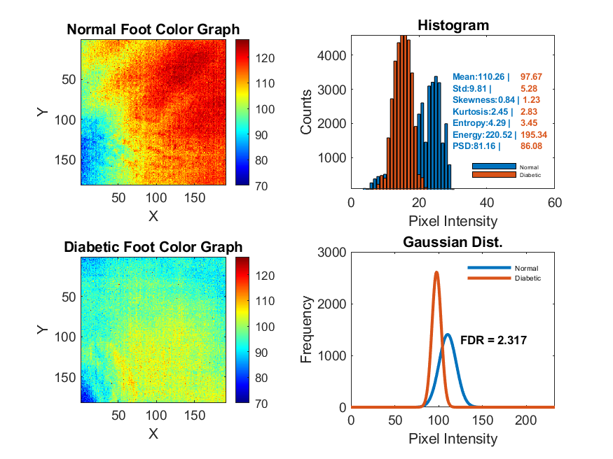
Normal Vs. Diabetic Foot (800 nm)

Slide 16
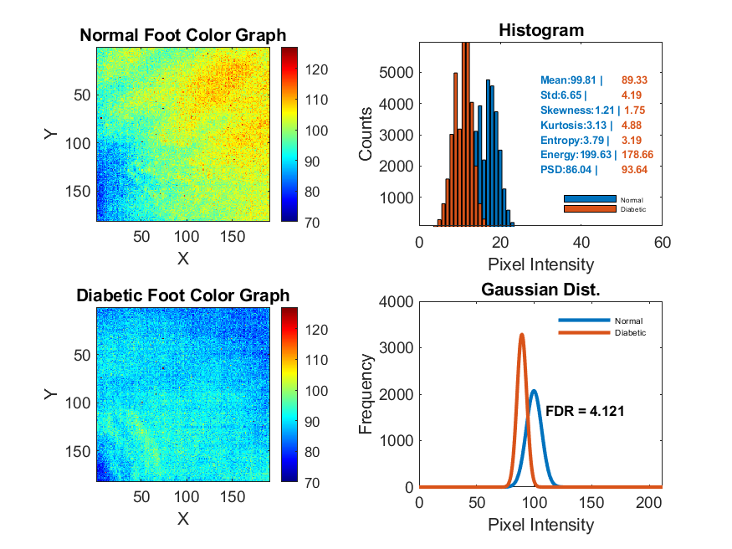
Normal Vs. Diabetic Foot (865 nm)

Slide 17
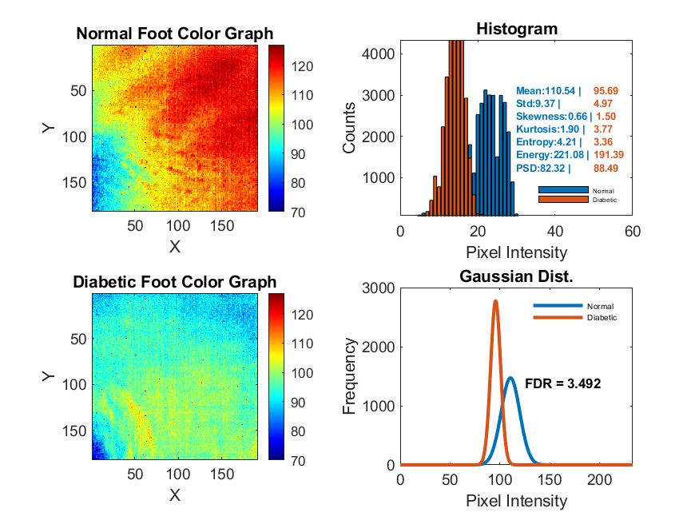
Normal Vs. Diabetic Foot (930 nm)

Slide 18
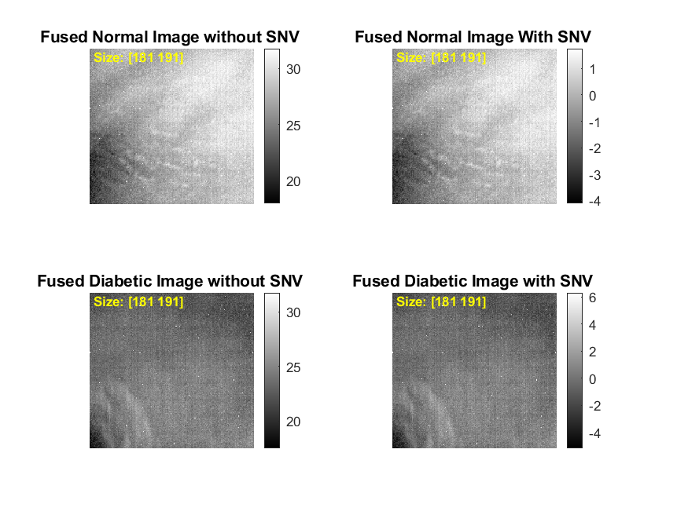
Fused Images
It is average image of all wavelength

Slide 19
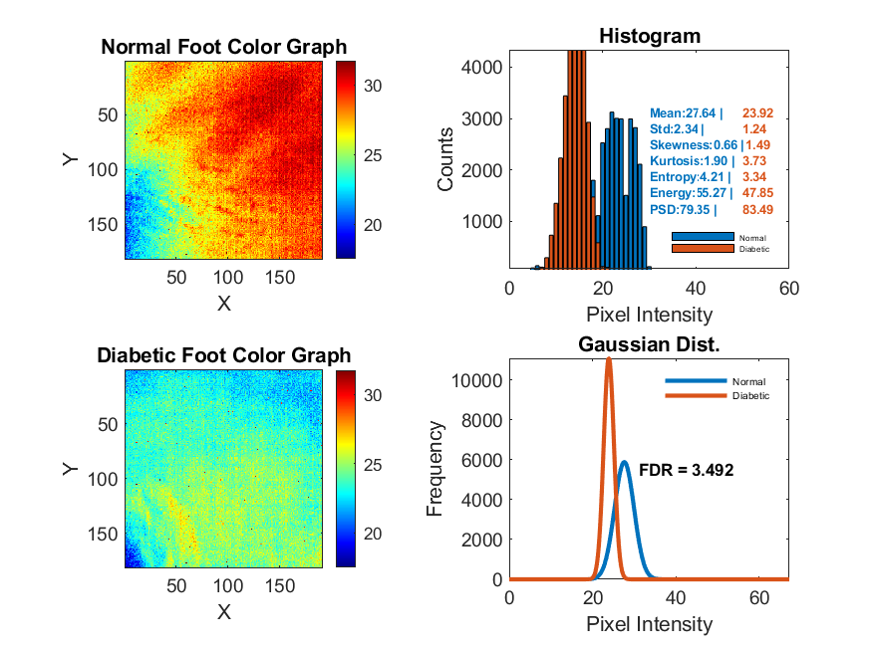
Fused Normal Vs. Diabetic Images (Without SNV)

Slide 20
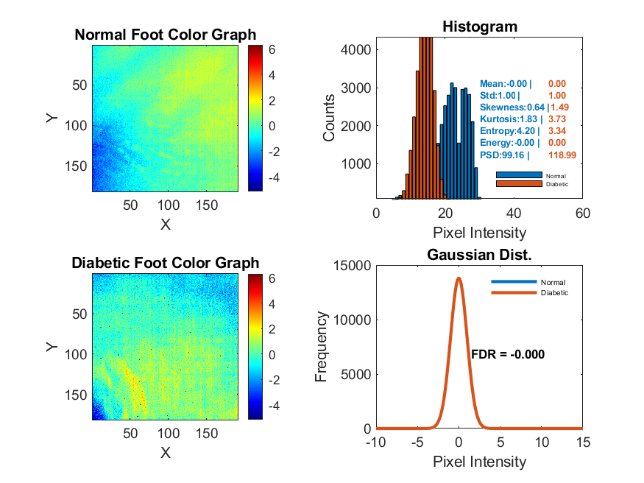
Fused Normal Vs. Diabetic Images (With SNV)

Slide 21
Relative Difference (Threshold above 10%)
wavelength | 735 nm |  |  | 800 nm |  |  | 865 nm |  |  | 930 nm |  |  | Fused (Without SNV) |  |  | Fused (With SNV)
Params | Normal | Diabetic | Change(%) | Normal | Diabetic | Change(%) | Normal | Diabetic | Change(%) | Normal | Diabetic | Change(%) | Normal | Diabetic | Change(%) | Normal | Diabetic | Change(%)
Mean | 100.39 | 89.55 | 10.8 | 110.26 | 97.67 | 11.42 | 99.81 | 89.33 | 10.5 | 110.54 | 95.69 | 13.43 | 27.64 | 23.92 | 13.43 | 0 | 0 | 0
Std | 7.55 | 4.31 | 42.94 | 9.81 | 5.28 | 46.19 | 6.65 | 4.19 | 36.96 | 9.37 | 4.97 | 46.98 | 2.34 | 1.24 | 46.98 | 1 | 1 | 0
Skewness | 1.04 | 1.96 | 88.96 | 0.84 | 1.23 | 46.46 | 1.21 | 1.75 | 44.34 | 0.66 | 1.5 | 126.47 | 0.66 | 1.49 | 124.1 | 0.64 | 1.49 | 132.22
Kurtosis | 2.73 | 5.53 | 102.54 | 2.45 | 2.83 | 15.77 | 3.13 | 4.88 | 55.6 | 1.9 | 3.77 | 98.11 | 1.9 | 3.73 | 96.11 | 1.83 | 3.73 | 104.22
Entropy | 3.94 | 3 | 23.77 | 4.29 | 3.45 | 19.43 | 3.79 | 3.19 | 15.66 | 4.21 | 3.36 | 20.19 | 4.21 | 3.34 | 20.7 | 4.2 | 3.34 | 20.42
Energy | 200.79 | 179.1 | 10.8 | 220.52 | 195.34 | 11.42 | 199.63 | 178.66 | 10.5 | 221.08 | 191.39 | 13.43 | 55.27 | 47.85 | 13.43 | 0 | 0 | 0
PSD | 82.22 | 80.6 | 1.98 | 81.16 | 86.08 | 6.07 | 86.04 | 93.64 | 8.83 | 82.32 | 88.49 | 7.49 | 79.35 | 83.49 | 5.21 | 99.16 | 118.99 | 20
FDR |  |  | 3.06 |  |  | 2.32 |  |  | 4.12 |  |  | 3.49 |  |  | 3.49 |  |  | 0.00

Slide 22
Summary(#16)
Skewness
Highest change: 132.22% (Fused with SNV)
Consistently high across wavelengths (e.g., 126.47% at 930 nm, 88.96% at 735 nm)
Kurtosis
Very high change: 104.22% (Fused with SNV), 102.54% (735 nm), 98.11% (930 nm)
Std
Change peaks at 46.98% (930 nm and Fused without SNV)

Slide 23
FDR in all Diabetic Feet
735 nm | 800 nm | 865 nm | 930 nm | Remarks
4 | 5 | 7 | 3 | No Img Proc.
9 | 2 | 3 | 5 | Img Proc.
13 | 7 | 10 | 8 | Total

Slide 24
Thank You !

